Slide 1
Physical computing from Scratch using scratchClient – Intermediate Control servos, LEDs and more from Scratch using RPi, Arduino, scratchClient
Hans de Jong & Gerhard Hepp
Pi And More 10 1/2
Stuttgart – 24 February 2017

Slide 2
Part 1: Adding analog input

Slide 3
Changing the wiring on the board
When changing the wiring on the board
First pull the USB cable out
Switch off the 9V supply

Slide 4
The electronics of a potentiometer
The potmeter is a resistor that will be connected between 5 V and 0 V.
Over the length of the resistor the voltage drops linearly.
E.g. in the middle it would be 2.5 Volt
So this is an analog signal. The value can be changed between 5 V and 0 V.
There is a 1 kOhm resistor in series for the reasons discussed earlier
+5 Volt
Consider what would happen if the 1 kOhm resistor were not there and the port would be used as output and potmeter positioned close to the 0 Volt side.
Then the Arduino would output 5 Volt, and the potmeter is directly leading it to the 0 Volt line → short circuit!
Arduino
1 kOhm
Potentiometer
Analog input
10 kOhm
Resistor
0 Volt

Slide 5
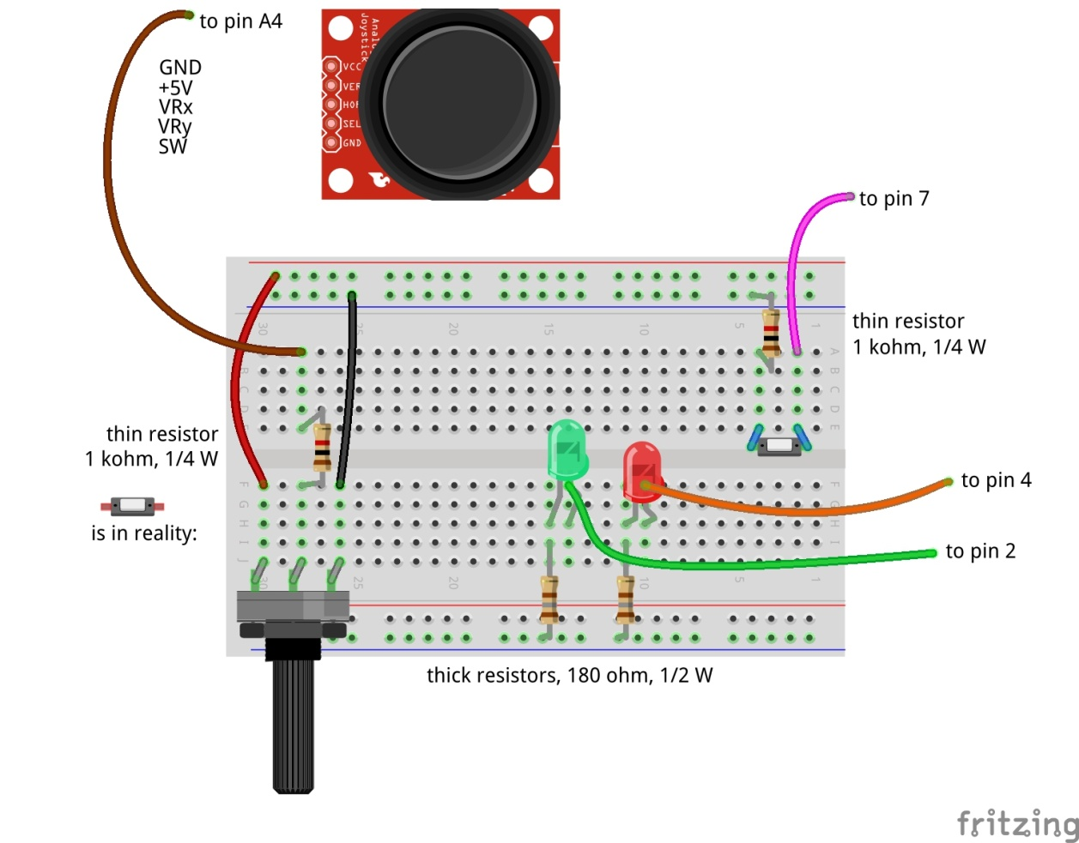
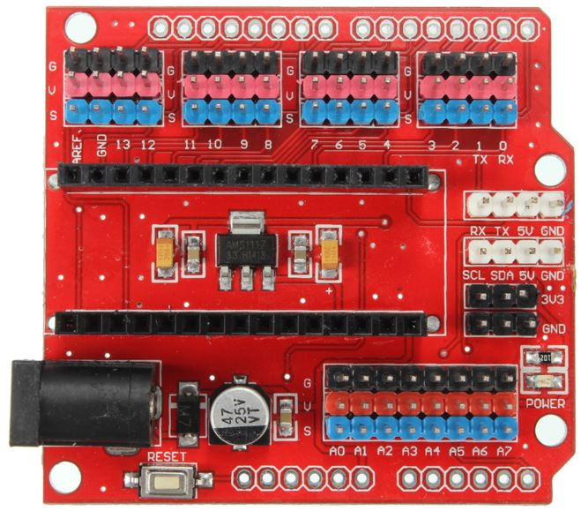

Adding analog input
Don’t forget: power off and USB cable out before making changes!

Slide 6
Update the config file
Update the config file again (right click PiAndMoreConfig.scl on the desktop, scratchConfig Edit)
Define Potmeter on pin A4 (direction: in, function: analog)
Now that you are updating anyway, already define for the next steps:
Define Servo1 on pin 12 (direction: out, function: servo)
Define BigBlueLED on pin 5 (direction: out, function: PWM)
Define Buzzer on pin 11 (direction: out, function: PWM)
Don’t forget to save. Keep the config editor open.

Slide 7
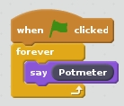
Test whether it works
Reconnect and repower the board
Stop and restart scratchClient by double clicking PiAndMoreConfig.scl on the desktop
Make this piece of program and run it
Turn the knob and see the values of Potmeter change
Between about 0 and about 1024
We will write some Scratch program to use it in the next step

Slide 8
Part 2: Pulse Width Modulation

Slide 9
Where we are …
We have seen:
Digital Input (the button) (in the beginners module)
Digital Output (the LEDs) (in the beginners module)
Analog Input (the potentiometer)
So what would be most logical next?
Analog Output? → but it does not exist!
However there is a good alternative: Pulse Width Modulation

Slide 10
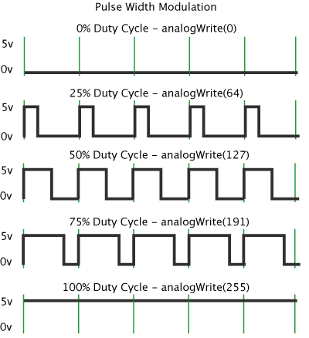
Pulse Width Modulation (PWM)
By modulating (changing) the pulse width, the amount of energy fed to e.g. the LED is changed, and hence the intensity with which you see it lighting.
Note that in practice the LED is blinking some 800 blinks / second.
However, no human eye can see more than 100 blinks / second.

Slide 11
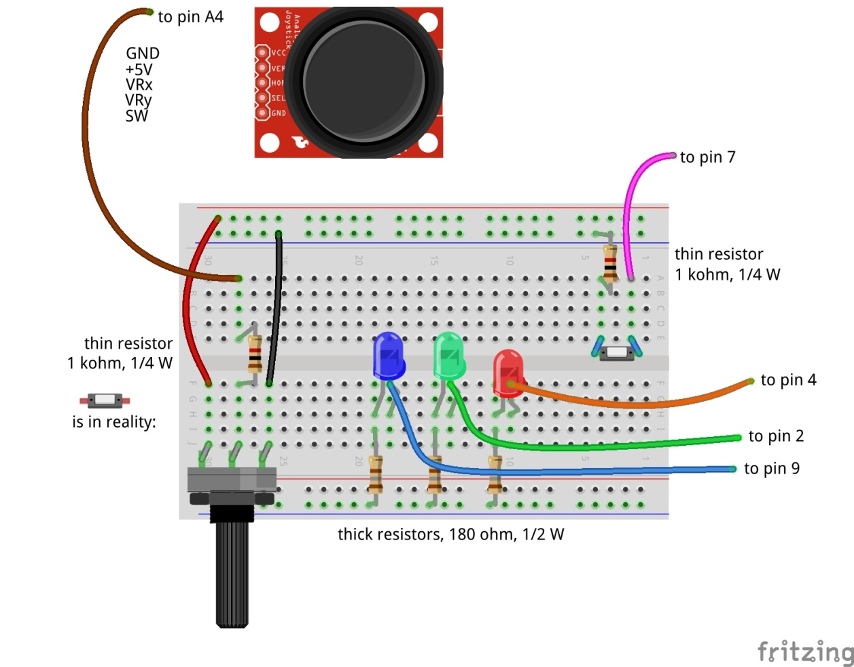
Dimming the BigBlueLED with PWM
to pin 5
Don’t forget: power off and USB cable out before making changes!

Slide 12
Test
Switch the power on again and reconnect
You will see that scratchClient finds the board again
You already updated the config file in the previous step, so no need to restart scratchClient
Send BigBlueLED values between 0 and 255
You can use the slider on the displayed variable for values between 0 and 100
For values above 100 we will use a program, see next slide
Does the LED brightness change?

Slide 13
Connect Potmeter and Big Blue LED (via Scratch)
Make some code that takes the potentiometer reading (between 0 and 1024) and transforms it into the range 0 to 255 (so divide by 4) and set the value of BigBlueLED.
Try out whether turning the potmeter changes the light intensity.
Notice that when turning to the right, the intensity goes down.
You would expect it to go up …
How can you very simply change this by interchanging two wires?

Slide 14
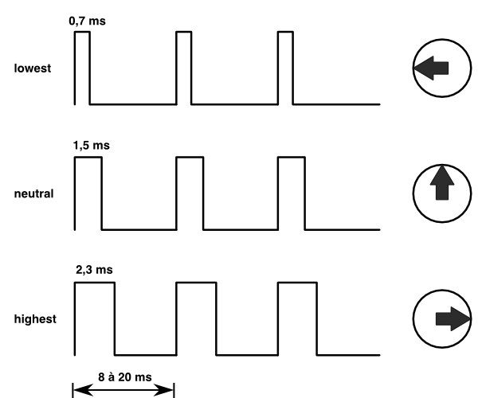
Controlling a servo with PWM
The position of the servo is changed by sending pulses of different width.
The servo looks at the pulsewidth and turns as desired.
The servo gets power separately.
With a servo, the pulse width modulation is not controlling the amount of energy fed to the servo
With a servo, pulse width modulation is rather a communication protocol.

Slide 15
Adding the servo to pin 12
to pin 5
Dark brown wire here
Don’t forget: power off and USB cable out before making changes!

Slide 16
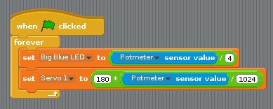
Testing the servo
Reconnect and repower the board
In Scratch, create a variable Servo1 and make it visible.
Try out giving it values between 0 and 100 via the slider on the variable.
The servo can handle values between 0 and 180
Does it move?
Update the loop where you set the Big Blue LED value dependent on the potmeter reading to now also set Servo 1.
But watch out: values have to be between 0 and 180.
To avoid overflow: first divide by 1024, then multiply by 180.
You may observe jitter.
Because the values of the potmeter will drift a bit and there will be power fluctuations, the reading of the potmeter will not be constant.
We will in the advanced workshop show how to deal with jitter

Slide 17
Controlling a buzzer with PWM
The buzzer will sound if it gets a signal in an audible frequency range.
A PWM signal on Arduino gives ca. 800 Hz.
Different for different pins
You will see that there is not much influence by changing the duty cycle.

Slide 18
Connect the buzzer to pin 11
Carefully watch the wires. Connect Vcc, GND and I/O correctly!
to pin 5
Don’t forget: power off and USB cable out before updating!

Slide 19
Testing the buzzer
No need to restart scratchClient, because the config file was not changed.
Define a variable Buzzer in Scratch
Give it values between 0 and 100
Using the slider on the variable
Does the value have much impact?
Add the setting of the buzzer to the loop where you already set the servo and the Big Blue LED.
Like with the LED, the values must be between 0 and 255.
Only test a short time (to save the ears of your neighbors ☺).

Slide 20
PWM limitations of Arduino (Nano and Uno)
General PWM is available on pins 3, 5, 6, 9, 10, 11
Servo can be configured on those pins, but also on 2, 4, 7, 8, 12
If a servo is configured on any pin, pins 9 and 10 cannot be configured as PWM anymore.
The config tool will warn you if you do it wrongly.

Slide 21
Part 9: Make a Scratch program
Extra material in case you have time left

Slide 22
Integrate with sprites
Load the following sprite
Big Red LED
Sits in the PiAndMore folder on the desktop in a folder Sprites.
Take a look at the code of the sprite.
Update the code that you wrote earlier today for the BigRedLED so that it sends messages to the sprite to turn the LED on and off

Slide 23
Add the Big Green LED sprite
Same that you did with the Big Red LED sprite, but now for the Big Green LED sprite.

Slide 24
Add the Big Blue LED sprite
Load the Big Blue LED sprite
Analyse the code in that sprite, which is different
The Big Blue LED sprite will move over the screen as the intensity changes
You can also move it with your mouse and see the intensity change.
Update your code that you wrote earlier to make use of the sprite.

Slide 25
Part 10: Take your work home

Slide 26
Do you want to take your work home?
If you brought your own USB stick, then connect it and copy the PiAndMore folder on the desktop
The rest of the material you can download from www.github.com
Take the flyer with you to remember where to find the material on github.

Slide 27
Part 11: Summary & take aways

Slide 28
Take aways of the beginners workshop
With scratchClient you define:
Function of each pin
Symbolic name for each configured pin
scratchClient config is the tool to setup the configuration
Restart scratchClient after you changed the configuration
Put a resistor in series with LEDs
Put a resistor in series with switches
Put a resistor in series with the middle contact of a potentiometer.
Configure a pull up resistor if the input signal goes between 0 Volt and being open rather than between 0 Volt and 3 to 5 Volt.
Output signals are controlled from Scratch by giving a variable a value
Input signals are monitored by the sensor programming elements
You can monitor the value of all pins from the browser
scratchClient can do much more…
Functions that a pin on Arduino can have:
Digital In
Digital Out
Analog In
No Analog Out
Pulse Width Modulation as alternative
For modulating the brightness of a LED
For controlling a servo
For controlling a buzzer
There a few more, see the advanced workshop
You can configure pull up resistors on Digital In

Slide 29
End of the intermediate workshop

Slide 30
If you want to know more …
Join the advanced workshop
Download the material and read the extensive documentation

Slide 31
Part 12: Clean up / teardown

Slide 32
If you continue to the Advanced Workshop …
You can continue to use your setup, with one exception:
You need to move the Big Blue LED to pin 9
Direction: out, function: output (so no PWM)
In the mean time you should know how to do this, otherwise please ask.

Slide 33
If your scratchClient day ends here …
Unplug the board from USB and power off the device
Please remove all components and wires from the breadboard
Remove all wires from the Arduino board.
Leave the wires on the 3 color LED (you did not use that)
Leave the wires on the buzzer
If something is broken, please
Throw it away or hand it in (if it is unclear)
Put a note in the box that it is missing
Do not put anything that is broken back in the box
Leave the Arduino running
Let us know what you thought about this workshop, now orally or later by email
hans.piam@hanselma.nl
heppg@web.de

Slide 34
More information
All workshop material
www.github.com and search for Weekendschool or for PiAndMore
scratchClient
http://heppg.de/ikg/wordpress/?page_id=6
Scratch
https://scratch.mit.edu/
Scratch on Raspberry Pi
https://www.raspberrypi.org/forums/viewforum.php?f=77
Raspberry Pi
https://www.raspberrypi.org/
Arduino
https://www.arduino.cc/

Slide 35
Physical computing from Scratch using scratchClient – Advanced Control servos, LEDs and more from Scratch using RPi, Arduino, scratchClient
Hans de Jong & Gerhard Hepp
Pi And More 10
Trier – 24 June 2017

Slide 36
Before we start

Slide 37
If you do not roll over from the beginners workshop …
If you are familiar with scratchClient, but not with the new config tool …
… you may want to look at some slides of the beginners workshop
Other than that, you do not have to build up the complete setup what the people of the beginners workshop did.
Only those things on the next slide.
You will however see the components of the beginners workshop in the diagrams.
Just ignore those.

Slide 38
Make a script file to start scratchClient
Then make a new file in the PiAndMore folder on the Desktop
Call it StartSC.bash
Put this into the file (copy/paste from this presentation):
!# /bin/bash
sudo python ~/scratchClient/src/scratchClient.py -c ~/Desktop/PiAndMore/PiAndMore.xml
pause –p “Press Enter to continue”
Make the file executable (file properties, permissions)
Do you understand what the file does?
If not, please ask
Only to be done if you did NOT continue from the beginners workshop

Slide 39
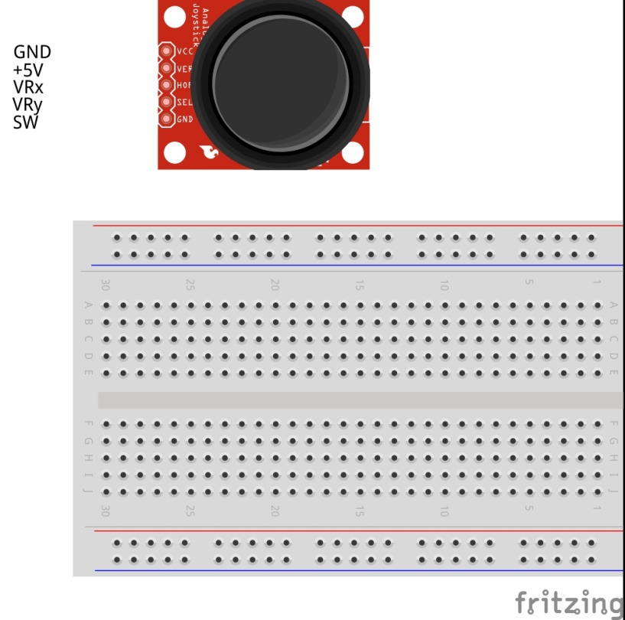
Connect the power wires
Only to be done if you did NOT continue from the beginners workshop

Slide 40
Make the config file for all steps
In order not to loose time, it is recommended to add all setups in the config file now.
If you continued from the beginners workshop then leave in what you have, only add.
D3: out, pwm, 3Color Red LED
D5: out, pwm, 3Color Blue LED
D6: out, pwm, 3Color Green LED
D8: in, counter_pullup, Counter button
D10: in, counter, IR sensor
- A0: in, analog, Rain Sensor
- A1: in, input_pullup, Tilt Sensor
- A2: out, output, Relay
- A3: in, analog, Sound Sensor
- A5: in, input_pullup, Joystick Button
- A6: in, analog, JoyStickY
- A7: in, analog, JoyStickX

Slide 41
Make variables
Save the config file
(Re)start scratchClient
In Scratch, create a variable for each of the out parameters.
Note: variable names are case sensitive.
In Scratch, make all of the sensors visible, so all in parameters.
Will only work if scratchClient successfully communicates to the board.

Slide 42
Choose the topics you want to give priority
The advanced workshop may be too short to do all activities.
So pick the order of the topics from the list
The red topics teach you more about scratchClient.
The green topics teach you more about electronics, sensors and engineering.
If you rather would do pieces of the beginners workshop then that is fine as well.
Joystick
Control position or control speed
Take care of calibration and drift
3-color LED
To make any color
Counter function
With button or IR slotted sensor
Rain sensor
Tilt sensor
Sound sensor
Strongly link the config file to the Arduino
For safety
For connection errors
Control multiple Arduinos concurrently
Power On Self Test
Controlling a relay
Controlling 220 Volt appliances (only info)
Controlling a camera (only info)

Slide 43
Joy stick

Slide 44
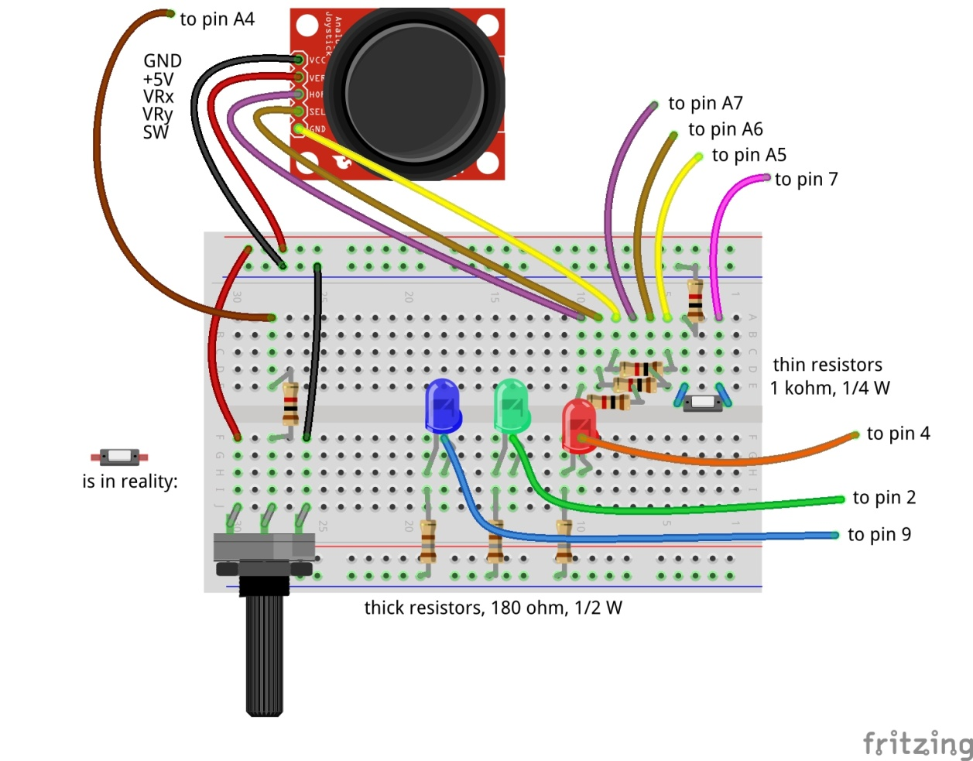
Adding the joy stick
X
Y
Don’t forget: power off and USB cable out before making changes!

Slide 45
Try it out
A joy stick has two small potentiometers and a button
When the joy stick is released (neutral position), the potentiometers are in the middle of the value range (middle between 0 and 1024)
There is one potentiometer for X and one for Y
The button is operated when pressing the button.
Reconnect and repower
Wait till the Arduino LED blinks slowly.
Now try moving and pressing the joy stick. Look at the 3 joy stick values to change
JoystickX and JoystickY between about 0 and about 1024.
Joystick Button between 0 and 1

Slide 46
Uses of Joysticks
You can directly use the value of the joystick
E.g. to control the position of a servo
E.g. to control the intensity of a LED
When releasing the knob, it will move back to the middle value.
E.g.: LED = JoystickX
You can alternatively use the joystick to determine the speed of the change
E.g. move a servo fast or slow. Let the servo stop at the latest position when you release the knob.
E.g.: LED = LED + (JoystickX – 512) / 200 (512 = neutral position value, 200 = sensitivity)
You can also use the Scratch pen function draw on the screen.
And e.g. use the potentiometer to change pen width or color.
Take care of drift and jitter (see next slide)

Slide 47
Take care of drift and jitter
Not all joysticks will give the same value if they are in the middle position
Influenced by temperature, the value produced in the middle position can drift over time.
Therefore build in some threshold around the middle position
If the middle position is 512, then do only react if the value changes by at least ca. 15, so e.g. > 525 or < 500.
Whether 15 is enough as threshold you will learn over time. Increase the value if it drifts more than that.
If you have a general program that works with several joysticks then you may have to use a larger threshold, or you need to calibrate (adapt the program for each particular servo).

Slide 48
Control a 3-color LED
To make all colors

Slide 49
Control a 3-color LED
Don’t forget: power off and USB cable out before making changes!
A 3-color LED has 3 LEDs in one package
Green
Red
Blue
Use PWM to change the intensity of each color
In that way you can create the entire spectrum of light
Including white light
Connect the 3-color LED carefully to the pins as defined in the config file.
Also connect the minus (–) pin to GND
Reconnect and repower
No need to restart scratchClient (since no update to the config file was made)
Give the corresponding variables in Scratch values between 0 and 100 with the slider on the variable.
Does it work?
We will see in the next slide how to use values between 0 and 255

Slide 50
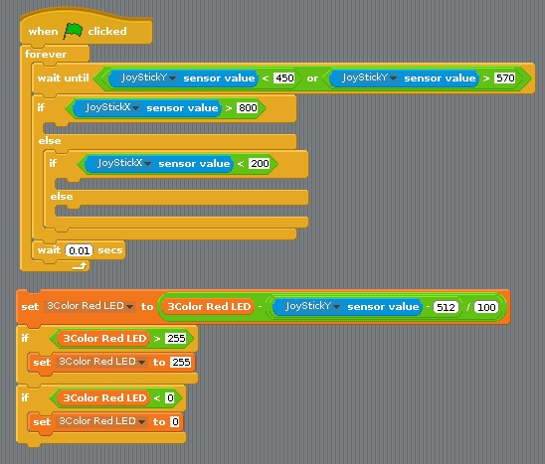
Connecting the 3-color LED to the joy stick (via Scratch)
Write a program in Scratch that:
Uses the value of the X direction of the joy stick to determine red, green or blue
Uses the value of the Y direction to change the intensity of the respective LED
When releasing the joy stick, the colors should stay
You will need these elements
You need this block 3 times for the 3 colors

Slide 51
The new counting function

Slide 52
Why a special counting function?
You can count in Scratch, however you can only reliably count a few pulses per second.
With this new counting function, you can do it much faster
If you need to detect small pulses that scratchClient may not see reliable, you can use a counter function to detect whether a (short) pulse did arrive.

Slide 53
Counter function using a button
It will count up. It will wrap round at a very large value that will be reached after days of counting.
Max. ca. 80 counts per second = 4800 per minute
There is a 4 ms debouncing delay
So multiple pulses within 4 ms will processed as a single count
So no need for capacitors to do debouncing

Slide 54
Debouncing
If a mechanical switch is operated, it can generate a series of pulses rather than one.
This is because one of the metal pieces bounces back a few times before it stays in position.
You would normally need take care of this if you want to get a single pulse
E.g. add a capacitor.
scratchClient will on the digital input pins only sample with 10 Hz, so it is unlikely that you will experience bounce problems.

Slide 55
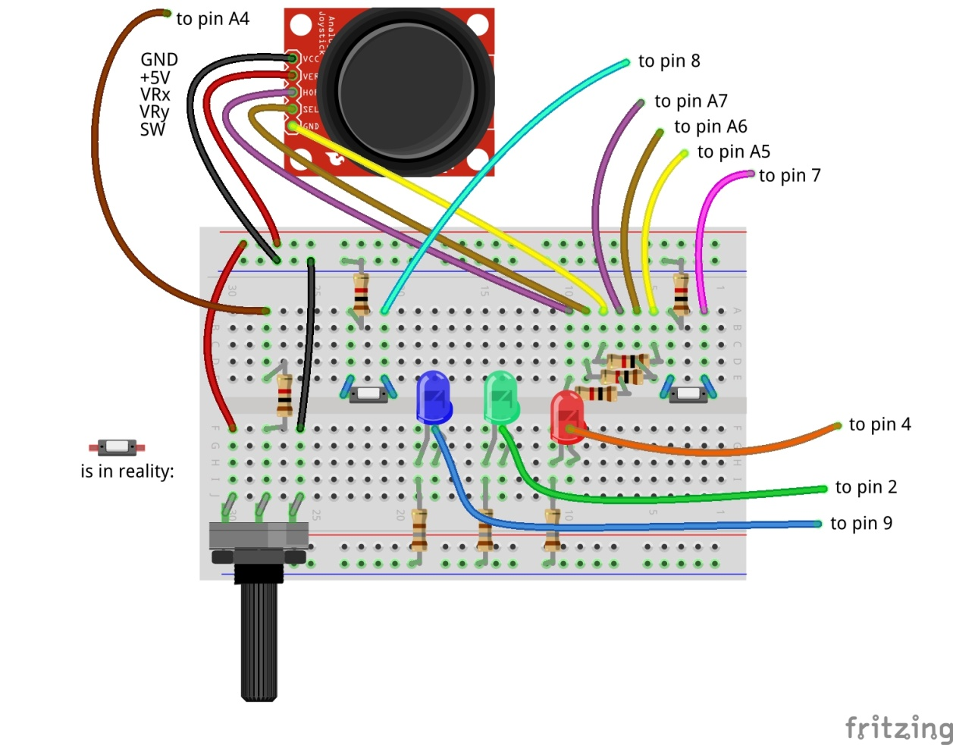
Adding the count button
Don’t forget: power off and USB cable out before making changes!

Slide 56
Adding an IR speed sensor that counts on pin 10
Carefully follow the wires to connect correctly!
Don’t forget: power off and USB cable out before making changes!

Slide 57
Differences between the counters
The IR sensor gives an output of 0 Volt or 5 Volt.
Therefore it does not need a pull up resistor (see the config file)
The button gives an output of 0 Volt or open.
Hence it needs a pull up resistor (as specified in the config file)

Slide 58
Try out the setup
The button you can just press.
The IR sensor you need to have good opaque material to let it work.
You can check the sensing by the LED at the backside.

Slide 59
Tilt sensor

Slide 60
Tilt sensor
The tilt sensor is a sensor containing a rolling ball between contacts.
You can hear it rattling if you shake it.
It is not in the box. We only have a few, so you will need to share.

Slide 61
Connect the tilt sensor to pin A1
Carefully follow the wires to connect correctly!
Don’t forget: power off and USB cable out before making changes!

Slide 62
Rain Sensor

Slide 63
Rain sensor
A rain sensor is an analog sensor that measures conductivity that is influenced by water.
It is not in the box. We only have a few, so you will need to share.

Slide 64
Connect the rain sensor to pin A0
Carefully follow the wires to connect correctly!
Don’t forget: power off and USB cable out before making changes!

Slide 65
Sound sensor

Slide 66
Sound Sensor
The sound sensor will detect sound.
It is a digital sensor that contains a microphone and will give 0 Volt if sound is detected, 5 Volt if no sound detected.
It is not in the box. We only have a few, so you will need to share.

Slide 67
Connect the sound sensor to pin A3
Carefully follow the wires to connect correctly!
Don’t forget: power off and USB cable out before making changes!

Slide 68
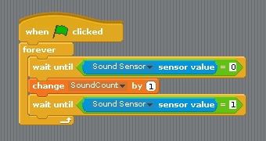
See the short pulses
The changes of the sound sensor are sometimes difficult to see just from the displayed sensor value
This code can be used to see that the sensor is actually working. You must create a variable SoundCount (or choose a different name) to hold the count.

Slide 69
Strongly link the config file to the Arduino

Slide 70
The ident functionality
You created a board, but maybe you have omitted some resistors and therefore damage would occur if it were used with the wrong config file.
That is what the ident functionality is for
Configure an identity in the Arduino
Specify the identity in the config file

Slide 71
Programming the ident in the Arduino
Have the Arduino connected
Start the Arduino IDE
Go to monitor mode
Set the speed to 115200
Set the line end to newline
You can now type commands in the window.
Type:
cident:PiAndMore10
cident? (you should get the string back)
Put in the config tool the value PiAndMore10 in the field Parameter ident.pattern

Slide 72
Testing ident functionality
Start scratchClient and see that it works
Now change the value of the ident in the config file.
Hardly matters what
Start scratchClient again and see that it will be rejected

Slide 73
More about ident
The ident can in the config file be specified as a regular expression. E.g.:
A dot (.) matches any character
A star (*) repeats the previous character (0 or more times)
If you want to know more about regular expressions, see e.g. http://www.rexegg.com/regex-quickstart.html
So you could specify
PiAndMore.* and it would work when PiAndMore9, PiAndMore10 or PiAndMore100 is programmed in the ident of the Arduino
Ident is also needed to identify a specific Arduino if multiple will be connected concurrently (see next slides).

Slide 74
Controlling multiple Arduinos

Slide 75
Control multiple Arduinos
Running out of pins on one Arduino? Connect more of them!
The /dev/ttyUSBnn port in the config file will define which part of the configuration is used for which Arduino.
Using the ident functionality (see previous topic) can be used to check that the correct Arduino was connected to the intended port.
You can get the Arduinos on the correct ports by connecting them always in the same sequence.

Slide 76
Creating a config file for multiple Arduinos
First create two separate config files for each Arduino and test them out.
The config tool can only work on a single adapter at a time.
Now create a new .xml file, and
Copy in the first file completely
Take the adapter section (most of the file) of the second file and paste this after the first adapter
Adapt the USB port in one of the files (make the board that you connect last /dev/ttyUSB1.

Slide 77
Trying it out – merge and config
Take the Weekendschool board with the Duck
Test it out with the config file and the Scratch program
Merge the two files in the way described.
Make the Weekendschool board /dev/ttyUSB1.
Disconnect both boards.
Restart scratchClient with the merged file.
Connect the workshop board first. It will become /dev/ttyUSB0.
Connect the Weekendschool board second. It will become /dev/ttyUSB1.

Slide 78
Trying it out – Control from Scratch
In the Scratch program of the workshop, define these variables
Tiltservo
Panservo
Try giving them values between 0 and 100 with the slider on the variable.
Does the duck tilt and pan?

Slide 79
Making the /dev/ttyUSBnn not matter anymore
In the way described before, the Arduinos must be connected in a specific sequence
You can alternatively use a program that will
Look at the connected boards (using the ident string)
Give a selection option to start with config files for which all the boards are present.

Slide 80
Explaining the startup tool

Slide 81
Power on self test (POST)

Slide 82
Power on self test (POST)
See the Weekendschool board with the duck.
When setting up the lesson, one wants to be able to quickly see whether the board works correctly.
Also, when the boards have to be packed, the duck should bow deep to make sure it fits in the box.
Moving servos by hand is not preferred.
The scratchClient Arduino sketch has a place where you can insert your own code to realise this functionality.

Slide 83
How to do the POST?
You will need to address the pin numbers directly. You cannot make use of the config file of scratchClient.
See the Arduino sketch of the Weekendschool board.
Between the xxxx and yyyy markers
Now try on the PiAndMore board to lite 3-color LED
0.5 seconds Red
0.5 seconds Green
0.5 seconds Blue
0.5 seconds White
Load the sketch in the board and look whether it works.

Slide 84
Controlling a relay

Slide 85
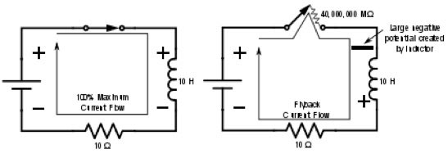
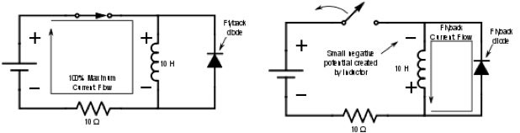
Controlling a relay
Controlling a relay like controlling a LED? NOT a good idea!
A relay has a coil that stores energy when powered.
When breaking the current flow, the voltage over the relay coil can get so high that it destroys the Arduino – and more.
At least a flyback diode should be used.

Slide 86
Other issues – and the solution
Often the current of the coil will be too high to drive directly from the Arduino
So a transistor will be needed.
Solution
Use a relay module with an opto coupler
Cost is generally not an issue. The relay module we use here is < € 1.
We only have a few relays today, so you will need to share.

Slide 87
Connect the relay module to pin A2
Carefully follow the wires to connect correctly!
Don’t forget: power off and USB cable out before making changes!

Slide 88
Use a servo to press buttons on appliances

Slide 89
Safely controlling 220 Volt appliances
You can in principle use a relay to control 220 Volt appliances.
However, this is not something you want to do in a classroom situation
Alternative: use a remote control and use servos to press the buttons.
See also the next slide.

Slide 90
Controlling a camera
Use a servo to press the button of the camera
Cannot do in the workshop
See the example setup in the workshop

Slide 91
What else can scratchClient do?

Slide 92
Can scratchClient do more? Yes!
It can also let you configure and use the GPIO pins on the Raspberry Pi itself.
However be aware:
There is no analog input on Raspberry Pi.
The pins are NOT 5 Volt tolerant (max 3.3 Volt).
The max current per pin on Raspberry Pi is lower than on Arduino.
If you blow up an Arduino (clone), the cost is limited to a few euro.
A Raspberry Pi is much more expensive.
scratchClient can also control Sonic Pi for high quality audio.
There are also Arduino sketches to control LED strips (Neopixel WS2812) and to control LEGO Power.
scratchClient can work with Scratch 2.0 (soon).
scratchClient can also run on Windows and then via Arduino control peripherals.
scratchClient can work with multiple Raspberry Pi configurations in a network.

Slide 93
Take your work home

Slide 94
Do you want to take your work home?
If you brought your own USB stick, then connect it and copy the PiAndMore folder on the desktop
The rest of the material you can download from www.github.com
Take the flyer with you to remember where to find the material on github.

Slide 95
Clean up / teardown

Slide 96
Unplug and pack up
Unplug the board from USB and power it off
Please remove all components and wires from the breadboard
Remove all wires from the Arduino board.
Leave the wires on the 3 color LED
Leave the wires on the buzzer
If something is broken, please
Throw it away or hand it in (if it is unclear)
Put a note in the box that it is missing
Do not put anything that is broken back in the box
Put everything in the box. The board goes on top
Shutdown the Arduino
Let us know what you thought about this workshop, now orally or later by email
hans.piam@hanselma.nl
heppg@web.de

Slide 97
More information
All workshop material
www.github.com and search for Weekendschool or for PiAndMore
scratchClient
http://heppg.de/ikg/wordpress/?page_id=6
Scratch
https://scratch.mit.edu/
Scratch on Raspberry Pi
https://www.raspberrypi.org/forums/viewforum.php?f=77
Raspberry Pi
https://www.raspberrypi.org/
Arduino
https://www.arduino.cc/

Slide 98
End of the Advanced Workshop

Slide 99
Appendix

Slide 100
Maximum current per pin
Max output current per pin = 20 mA
Total current for the board: 1 A
Note that also the potentiometer and the joystick take power

Slide 101
Calculation of the resistors

Slide 102
Cost of the setup (1 of 2)
This is a list of the cost of the setup of the external board.
Not included is the cost of the perspex board and the nuts and bolts, which are not an absolute minimum requirement
And for which there are alternatives, e.g. use cardboard or an MDF board
All material comes from Aliexpress
Very cheap
Often no shipping costs to Europe
Takes between 2 weeks and 2 months
Or never arrives, but then money is promptly returned.
When ordering below 22 euro, no import duties and handling costs

Slide 103
Cost of the setup (2 of 2)

Slide 104
The End

